Slide 1
Model validation and selection
Stephanie J. spielman, phd
bio5312, Fall 2017

Slide 2
PLEASE INSTALL "pROC"

Slide 3
Recall our models
Linear models
Logistic regression

Slide 4
Model validation and selection
Model Validation
What approaches can we use to evaluate the performance of a model?
What metrics can we use to measure model performance?
Model Selection
Given a set of possible models, how do we choose the "best" one?
How do we choose predictors, in particular main vs. interaction effects?
What metrics can we use to compare model performance?

Slide 5
Evaluating logistic regressions
> model <- glm(outcome ~ ., data=biopsy, family=binomial)
> new.patient <- tibble(clump_thickness = 4,
uniform_cell_size = 2,
uniform_cell_shape = 7,
marg_adhesion = 3,
epithelial_cell_size = 8,
bare_nuclei = 1,
bland_chromatin =5,
normal_nucleoli = 2,
mitoses = 0)
> predict(model, new.patient, type = "response")
1
0.2875157

Slide 6
Confusion matrix
TRUTH
 | Negative (False) | Positive (True)
Positive (True) | Type I error (False positive) | True positive
Negative (False) | True negative | Type II Error (False negative)
PREDICTION

Slide 7
Confusion matrix on the biopsy model
False positive
True positive
True negative
False negative

Slide 8
Emerging quantities
TRUTH
 | Negative (False) | Positive (True)
Positive (True) | FP | TP
Negative (False) | TN | FN
PREDICTION
True Positive Rate aka Sensitivity or Recall
TPR = TP/P = TP/(TP+FN)
True Negative Rate aka Specificity
TNR = TN/N = TN/(FP+TN)
False Positive Rate
FPR = FP/N = FP/(FP+TN) = 1 – TNR
Precision aka Positive Predictive Value (PPV)
TP/(TP+FP)
False discovery rate
FP/(FP+TP) = 1– PPV
Accuracy
(TP + TN) / (TP + TN + FP + FN)
Not enough for you? https://en.wikipedia.org/wiki/Confusion_matrix

Slide 9
Calculate these qualities for biopsy model
> model <- glm(outcome ~ ., data=biopsy, family=binomial)
### Predict on all the rows
> predict(model, biopsy, type = "response") %>% as.data.frame()
.
1 0.0160465814
2 0.9088086224
3 0.0081376226
4 0.7609349192
5 0.0181668485
6 0.9999736224
...

Slide 10
Calculate these qualities for biopsy model
> biopsy2 <- biopsy %>%
mutate(pred = predict(model, biopsy, type = "response") )
### Let's say >=0.5 is a prediction of malignancy ###
> biopsy2 %>%
mutate(pred.malignancy = ifelse(pred >= 0.5, "mal","benign")) %>%
group_by(outcome, pred.malignancy) %>%
tally()
outcome pred.malignancy n
<fctr> <chr> <int>
1 benign benign 434
2 benign mal 10
3 malignant benign 11
4 malignant mal 228
true negative
false positive
false negative
true positive

Slide 11
Evaluating the classifier
outcome pred.malignancy n
<fctr> <chr> <int>
1 benign benign 434
2 benign mal 10
3 malignant benign 11
4 malignant mal 228
true negative
false positive
false negative
true positive
TPR = TP / (TP + FN) = 228 / (228 + 11) = 0.953
FPR = FP / (FP + TN) = 10 / (10 + 434) = 0.023
TNR = 1 – FPR = 0.977
PPV = TP / (TP + FP) = 228/(228 + 10) = 0.957
Acc = (TP+TN) / (total) = (228 + 434) / (683) = 0.969

Slide 12
What about for any possible cutoff?
Receiver Operating Characteristic (ROC) curves are a common tool to diagnose the ability of a binary classifier
Quantify with metric AUC
Area Under the Curve (literally)
0.5 = random classification
1 = perfect classification
TPR = Sensitivity
FPR= 1 - Specificity

Slide 13
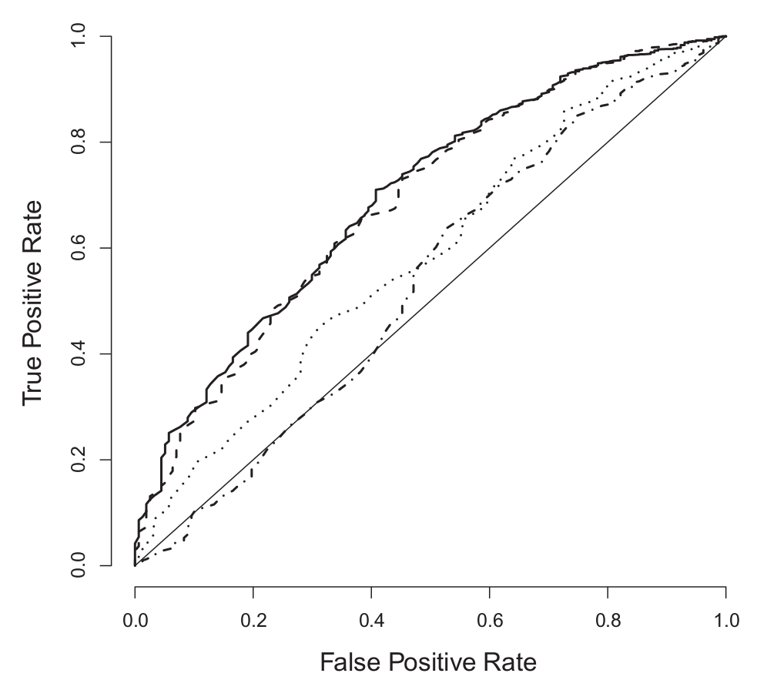
Real-life ROC curves
Keller, Mis, Jia, Wilke. Genome Biol. Evol. 4:80-88, 2012

Slide 14
ROC and AUC for our biopsy model
> library(pROC) ### You will have to install this package
## the 2nd argument can be either linear.predictors or fitted.values
> roc.object <- roc(biopsy$outcome, model$linear.predictors)
> roc.object$auc
Area under the curve: 0.9963

Slide 15
Visualize the ROC curve
> roc.data <- tibble(x = roc.object$specificities,
y = roc.object$sensitivities)
> ggplot(roc.data, aes(x = x, y = y)) +
geom_line() + scale_x_reverse() +
ylab("Sensitivity") +
xlab("Specificity")

Slide 16
Model selection via AUC
> tidy(model)
term estimate std.error statistic p.value
1 (Intercept) -10.103942243 1.17487744 -8.59999681 7.971831e-18
2 clump_thickness 0.535014068 0.14201743 3.76724220 1.650608e-04
3 uniform_cell_size -0.006279717 0.20907739 -0.03003537 9.760388e-01
4 uniform_cell_shape 0.322706496 0.23060065 1.39941710 1.616879e-01
5 marg_adhesion 0.330636915 0.12345089 2.67828703 7.399977e-03
6 epithelial_cell_size 0.096635417 0.15659236 0.61711452 5.371592e-01
7 bare_nuclei 0.383024572 0.09384327 4.08153469 4.473930e-05
8 bland_chromatin 0.447187920 0.17138238 2.60929928 9.072785e-03
9 normal_nucleoli 0.213030682 0.11287348 1.88734050 5.911454e-02
10 mitoses 0.534835631 0.32877389 1.62675821 1.037885e-01
> model1 <- glm(outcome ~ clump_thickness, data=biopsy, family=binomial)
> model2 <- glm(outcome ~ clump_thickness + marg_adhesion + bare_nuclei + bland_chromatin, data=biopsy, family=binomial)

Slide 17
Model selection via AUC
> model1 <- glm(outcome ~ clump_thickness, data=biopsy, family=binomial)
> roc1 <- roc(biopsy$outcome, model1$linear.predictors)
> roc1$auc
Area under the curve: 0.9089
> model2 <- glm(outcome ~ clump_thickness + marg_adhesion + bare_nuclei + bland_chromatin, data=biopsy, family=binomial)
> roc2 <- roc(biopsy$outcome, model2$linear.predictors)
> roc2$auc
Area under the curve: 0.9947

Slide 18
Directly compare ROC curves
> roc1.data <- tibble(x = roc1$specificities,
y = roc1$sensitivities,
model = "model1")
> roc2.data <- tibble(x = roc2$specificities,
y = roc2$sensitivities,
model = "model2")
> roc.both <- rbind(roc1.data, roc2.data)
> ggplot(roc.both, aes(x=x,y=y,color=model)) +
geom_line() + scale_x_reverse()

Slide 19
Breathe break

Slide 20
Linear model selection and evaluation
Quantities of model fit (how well does my model fit the data?)
R²
Likelihood
Akaike Information Criterion (AIC)
Bayesian Information Criterion (BIC)
> model <- lm(Sepal.Length ~ Petal.Length, data = iris)
> glance(model)
r.squared adj.r.squared sigma statistic p.value df
1 0.7599546458 0.7583327177 0.407074548 468.5501535 1.038667419e-47 2
logLik AIC BIC deviance df.residual
1 -77.02021159 160.0404232 169.0723291 24.52503377 148

Slide 21
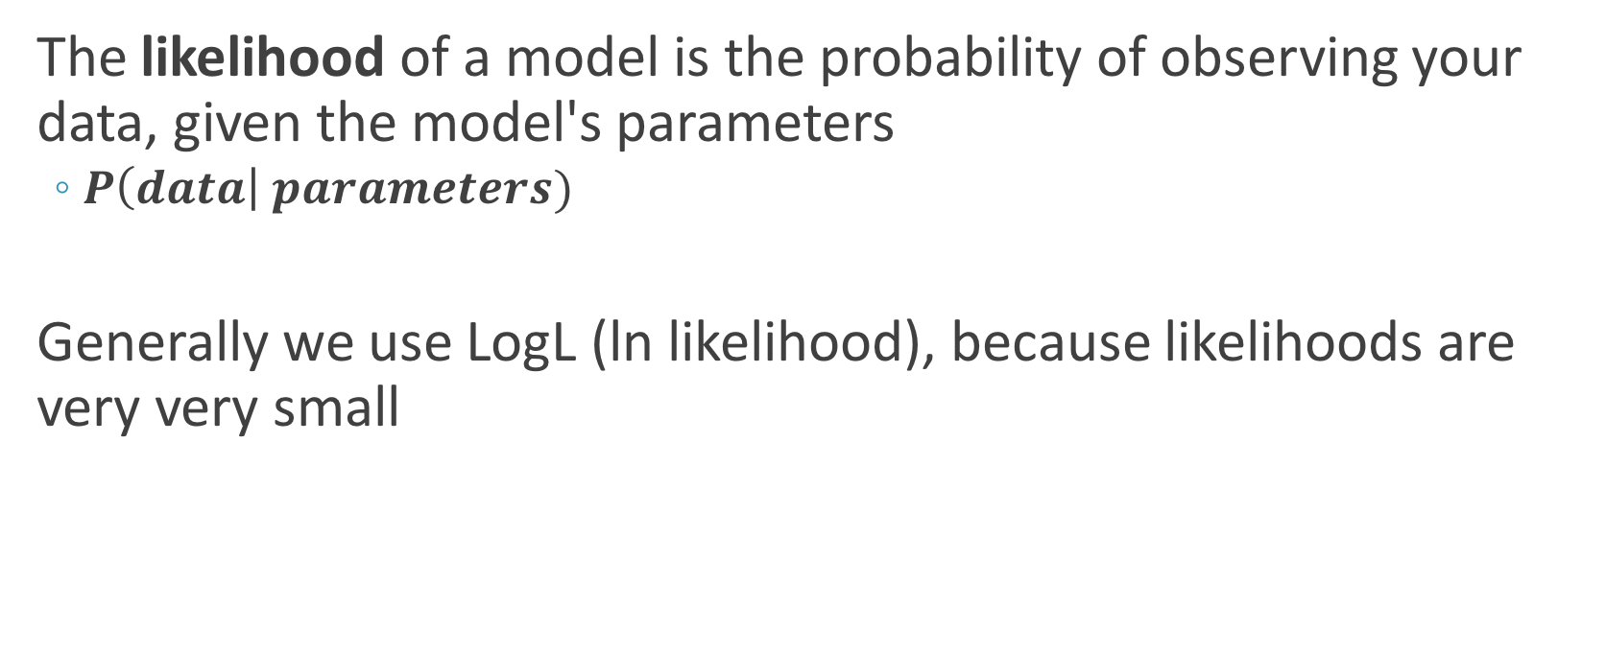
Likelihood
The likelihood of a model is the probability of observing your data, given the model's parameters
$P\left(data\right| parameters)$
Generally we use LogL (ln likelihood), because likelihoods are very very small

Slide 22

An example likelihood calculation
I flip a coin 500 times and get 380 heads, 120 tails. What is the likelihood of a model with p=0.5?
$$P\left(k successes\right)= \left({n \atop k}\right)p^{k}q^{(n−k)}$$
$P\left(380 successes | p=0.5\right)= \left({380 \atop 500}\right){0.5}^{380}{0.5}^{120}=$ 5.9e-30
LogL = ln(5.9e-30) = -74.21
> dbinom(380, 500, p=0.5)
[1] 5.9030476e-33
> log(dbinom(380, 500, p=0.5))
[1] -74.209839
> dbinom(380, 500, p=0.5, log=T)
[1] -74.209839

Slide 23
Maximum likelihood estimation (very simply)
Estimation approach to find the parameter value which maximizes the likelihood
> all.p <- seq(0, 1, by=0.01) #### 0, 0.01, 0.02,..., 0.99, 1.0
> all.logl <- dbinom(x=380, prob=all.p, size=500, log=T)
The parameter value which maximizes the LogL is the MLE
> p.logl <- tibble(x = all.p, y = all.logl)
> ggplot(p.logl, aes(x=x,y=y)) +
geom_line() +
xlab("Proportion p") +
ylab("LogL")
> p.logl %>% filter(y == max(y))
x y
<dbl> <dbl>
1 0.76 -3.176213056

Slide 24
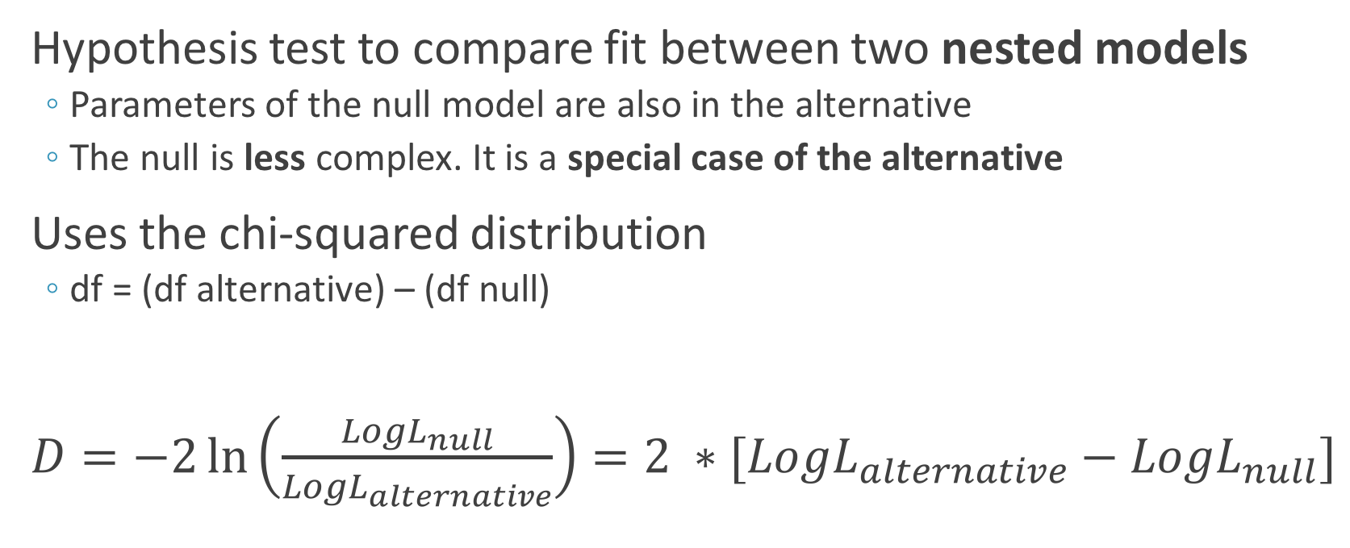
The likelihood ratio test (LRT)
Hypothesis test to compare fit between two nested models
Parameters of the null model are also in the alternative
The null is less complex. It is a special case of the alternative
Uses the chi-squared distribution
df = (df alternative) – (df null)
$D=−2\ln\left(\frac{{LogL}_{null}}{{LogL}_{alternative}}\right)=2 ∗[{LogL}_{alternative}−{LogL}_{null}]$

Slide 25
LRT null vs alternative: Which is which?
Null
Alternative
Outcome ~ x1 + x2 + x3
Outcome ~ x1 + x2 + x3 + x4 + x5
Outcome ~ x1 + x2 + x3 + 0 + 0

Slide 26
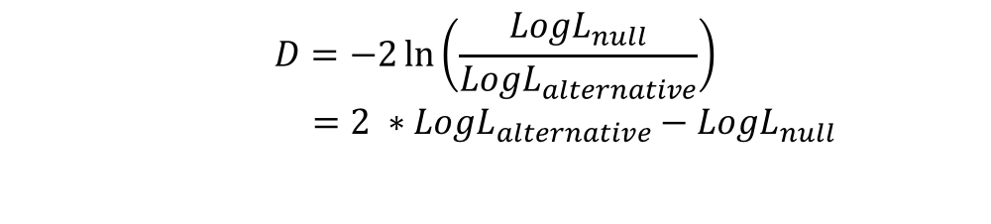
Performing a LRT
$$D=−2\ln\left(\frac{{LogL}_{null}}{{LogL}_{alternative}}\right)$$
$=2 ∗{LogL}_{alternative}−{LogL}_{null}$
> null_model <- lm(Sepal.Length ~ Petal.Length, data = iris)
> tidy(null_model) %>% select(term, estimate)
term estimate
1 (Intercept) 4.3066034150
2 Petal.Length 0.4089222774
> glance(null_model) %>% select( adj.r.squared, df, logLik)
adj.r.squared df logLik
1 0.7583327177 2 -77.02021159
> alt_model <- lm(Sepal.Length ~ Petal.Length + Species, data = iris)
> glance(alt_model) %>% select( adj.r.squared, df, logLik)
adj.r.squared df logLik
1 0.8333687938 4 -48.11637097
#### LRT #####
> D <- 2 * (-48.11637097 - -77.02021159) ### Comes out to 57.80768
> df <- 4 - 2
> 1 - pchisq(D, df)
[1] 2.799982468e-13
Y = 4.307 + 0.409X
→ The log likelihood of a model with estimated parameters 𝜷₀ = 4.307 and 𝜷₁ = 0.409 is -77.02
Evidence for model improvement in the alternative compared to the null.

Slide 27
LRT has very specific utility
Can only compare nested models
Can only compare two models
Not useful if I have 100 models and want to choose the "best" one
####### These are not appropriate for LRT #########
> null_model <- lm(Sepal.Length ~ Sepal.Width, data = iris)
> alt_model <- lm(Sepal.Length ~ Petal.Length + Species, data = iris)

Slide 28
Linear model selection and evaluation
Quantities of model fit (how well does my model fit the data?)
R²
Likelihood
Akaike Information Criterion (AIC)
Bayesian Information Criterion (BIC)
> model <- lm(Sepal.Length ~ Petal.Length, data = iris)
> glance(model)
r.squared adj.r.squared sigma statistic p.value df
1 0.7599546458 0.7583327177 0.407074548 468.5501535 1.038667419e-47 2
logLik AIC BIC deviance df.residual
1 -77.02021159 160.0404232 169.0723291 24.52503377 148

Slide 29


Comparing non-nested models
AIC and BIC take number of parameters into account to protect against overfitted models
Useful for: Is it worth the overfitting risk to have the additional parameters?
$$AIC=2∗(k −LogL)$$
$$BIC=k∗log\left(n\right)−2∗LogL$$
k = number of parameters
n = sample size
BIC penalizes more strongly

Slide 30
Bias-variance tradeoff in model fitting

Slide 31

Prefer model with lowest IC ($ΔIC\sim 2$)
> model1 <- lm(Sepal.Length ~ Petal.Length, data = iris)
> glance(model1) %>% select( AIC, BIC)
AIC BIC
1 160.0404232 169.0723291
> model2 <- lm(Sepal.Length ~ Petal.Length + Species, data = iris)
> glance(model2) %>% select( AIC, BIC)
AIC BIC
1 106.2327419 121.2859184
> model3 <- lm(Sepal.Length ~ Petal.Length * Species, data = iris)
> glance(model3) %>% select( AIC, BIC)
AIC BIC
1 106.7673053 127.8417524
> model4 <- lm(Sepal.Length ~ Sepal.Width * Petal.Length * Species, data = iris)
> glance(model4) %>% select( AIC, BIC)
AIC BIC
1 80.40596946 119.5442283
With AIC, we prefer:
model4 >> model2 ~=model3 >> model1
With BIC, we prefer:
model4 >~ model2 > model3 >>model4

Slide 32
Exhaustive searching in R (one option of millions)
> model <- lm(Sepal.Length ~ ., data = iris)
### Selection with AIC
> aic.backwards <- step(model, trace=F) ## trace=F reduces output vomit
> aic.forwards <- step(model, trace=F, direction = "forward")
#### Selection with BIC
> bic.backwards <- step(model, trace=F, criterion = "BIC")

Slide 33
Exhaustive search results
> glance(aic.backwards)
r.squared adj.r.squared sigma statistic p.value df
1 0.8673122616 0.8627050485 0.3068261031 188.2509525 2.666942494e-61 6
logLik AIC BIC deviance df.residual
1 -32.55801067 79.11602135 100.1904684 13.55648508 144
> glance(aic.forwards)
r.squared adj.r.squared sigma statistic p.value df
1 0.8673122616 0.8627050485 0.3068261031 188.2509525 2.666942494e-61 6
logLik AIC BIC deviance df.residual
1 -32.55801067 79.11602135 100.1904684 13.55648508 144
> glance(bic.backwards)
r.squared adj.r.squared sigma statistic p.value df
1 0.8673122616 0.8627050485 0.3068261031 188.2509525 2.666942494e-61 6
logLik AIC BIC deviance df.residual
1 -32.55801067 79.11602135 100.1904684 13.55648508 144

Slide 34
Breathe break

Slide 35
It matters what data you use to build a model
> iris %>% sample_frac(0.2) -> iris.sub1
> iris %>% sample_frac(0.2) -> iris.sub2
> m1 <- lm(Sepal.Length ~ Petal.Length, data = iris.sub1)
> glance(m1) %>% select(r.squared)
r.squared
1 0.8522912784
> m2 <- lm(Sepal.Length ~ Petal.Length, data = iris.sub2)
> glance(m2)
r.squared
1 0.7443233142
> test.data <- tibble(Petal.Length = 8.7)
> predict(m1, test.data, interval = "confidence")
fit lwr upr
1 8.174451411 7.791955193 8.556947628
> predict(m2, test.data, interval = "confidence")
fit lwr upr
1 7.833587103 7.325629373 8.341544834

Slide 36
A model is only as good as the data used to train it

Slide 37
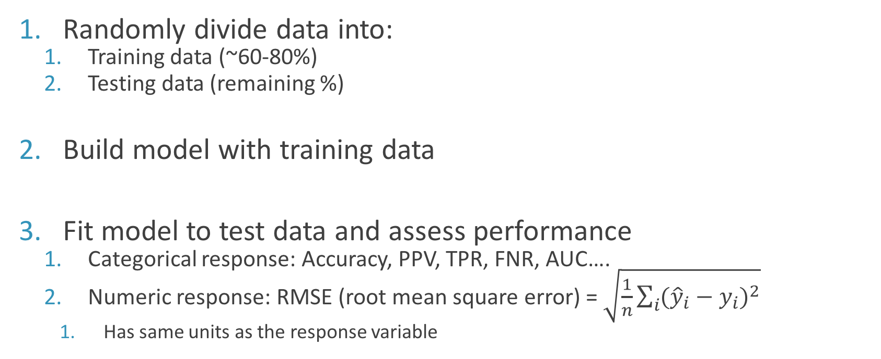
Model validation strategy
Randomly divide data into:
Training data (~60-80%)
Testing data (remaining %)
Build model with training data
Fit model to test data and assess performance
Categorical response: Accuracy, PPV, TPR, FNR, AUC….
Numeric response: RMSE (root mean square error) = $\sqrt{\frac{1}{n}\sum_{i}{{({\hat{y}}_{i}−y_{i})}^{2}}}$
Has same units as the response variable

Slide 38
First, a single test/train set
> iris.train <- iris %>% sample_frac(0.7)
> iris.test <- anti_join(iris, iris.train)
> trained.model <- lm(Sepal.Length ~ Petal.Length, data = iris.train)
### modelr::rmse(model, test.data) ####
> modelr:: rmse(trained.model, iris.test)
[1] 0.4103412
> summary(iris$Sepal.Length)
Min. 1st Qu. Median Mean 3rd Qu. Max.
4.300 5.100 5.800 5.843 6.400 7.900
> modelr:: rmse(trained.model, iris.train)
[1] 0.4035663
The RMSE in predicted Sepal Lengths on the test data is 0.41
RMSE is the same for training data, showing that our models is not biased towards mediocre data.

Slide 39
Test/train for logistic regression
> biopsy.train <- biopsy %>% sample_frac(0.7)
> biopsy.test <- anti_join(biopsy, biopsy.train)
> trained.model <- glm(outcome ~ ., data = biopsy.train, family=binomial)
### Mutate the predicted test outcomes into test data
> biopsy.test %>%
mutate(pred = predict(trained.model, biopsy.test, type="response")) %>%
select(outcome, pred) -> tested
> head(tested)
outcome pred
1 benign 0.006931554
2 benign 0.085382168
3 benign 0.018999048
4 benign 0.003708158
5 malignant 0.999934931
6 malignant 0.602477655

Slide 40
Compute various classifier metrics at 0.5 cutoff
> tested %>%
mutate(pred.malignancy = ifelse(pred > 0.5, "mal","benign")) %>%
group_by(outcome, pred.malignancy) %>%
tally()
# Groups: outcome [?]
outcome pred.malignancy n
<fctr> <chr> <int>
1 benign benign 51
2 benign mal 4
3 malignant benign 4
4 malignant mal 63
true negative
false positive
false negative
true positive
PPV = TP / (TP + FP) = 51/(51+ 4) = 0.927
Accuracy = (TP+TN) / (total) = (51 + 63) / (122) = 0.934

Slide 41
AUC calculations
> roc.train <- roc(biopsy.train$outcome, trained.model$linear.predictors)
> roc.train$auc
Area under the curve: 0.996
> test.predictions <- predict(trained.model, biopsy.test)
> roc.test <- roc(biopsy.test$outcome, test.predictions)
> roc.test$auc
Area under the curve: 0.9929
Consistency between training and testing data!

Slide 42
ROC curves for training and testing
> roc.data.train <- tibble(x = roc.train$specificities,
y = roc.train$sensitivities,
model = "train")
> roc.data.test <- tibble(x = roc.test$specificities,
y = roc.test$sensitivities,
model = "test")
> rbind(roc.data.train, roc.data.test) %>%
ggplot(aes(x=x, y=y, group=model, color=model)) +
geom_line() +
scale_x_reverse()

Slide 43
K-fold cross validation is common and powerful
Split data randomly into k evenly spaced chunks
K=10 is a good choice, K=5 for smaller datasets
Take first chunk as testing, and remaining chunks as training
Evaluate on test data
Repeat k times, so each chunk is used once as a test set

Slide 44
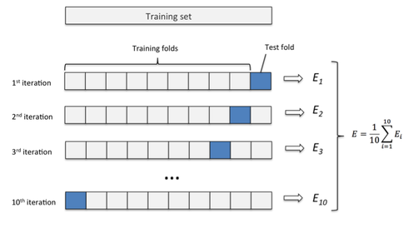
K-fold cross validation
Special case is Leave-one-out cross validation (LOOCV), where k=n

